Slide 1


Group Members:
M. Ammad Hassan (m.ammadhassan@yahoo.com)
Huraira Malik (hurairamalik2200@gmail.com)
Yasir Ali (ali.yasir343@gmail.com)
Instructor:
Muneer Khan
Presented To:
Mamoon Raza

Slide 2
Bus Travelling Website
Visit to our website:
hay-travels.web.app

Slide 3
Why We Choose This Project?
To serve the Pakistani passengers with international standard buses on minimum fares.
To facilitate the passengers with online booking of bus ticket.
To allow passengers to pay their ticket price online with flexible ways.

Slide 4
Who We Are?
H.A.Y. Travels is a bus company which gives facility with instant booking and comprehensive choices.
H.A.Y. Travels provides highest standard of service.
H.A.Y. Travels has dedicated customer support operating 24/7.
H.A.Y. Travels is there for you, whenever and wherever.

Slide 5
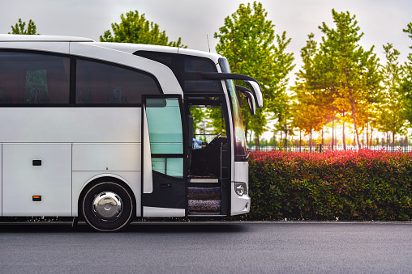
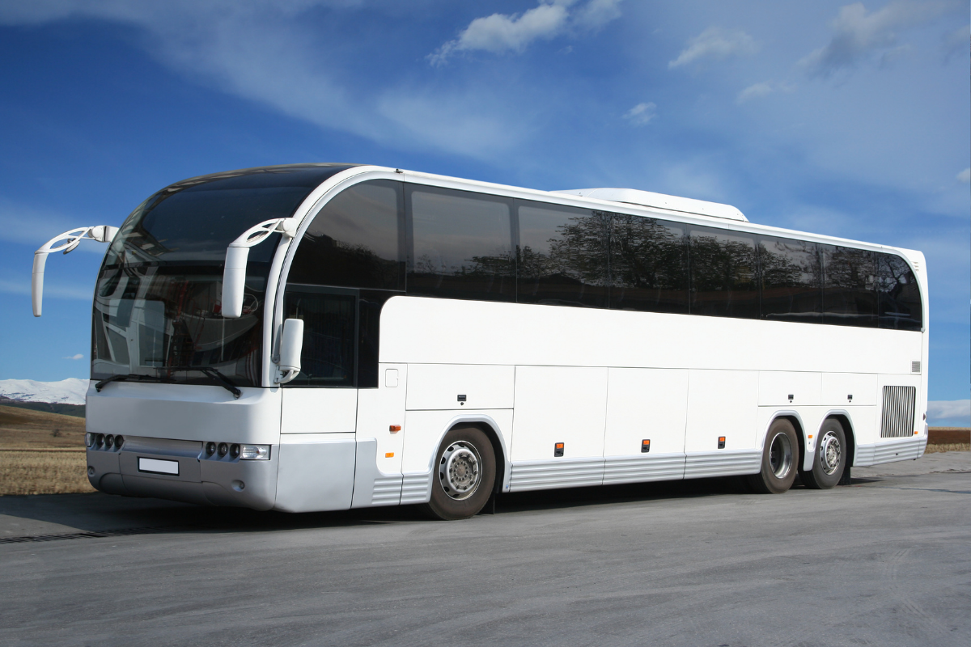
- Our Mission -
Make your travelling experience joyful and comfortable.

Slide 6




Tools

Slide 7

Languages
HTML
CSS
JS

Slide 8
Challenges
Choosing a template for travelling website.
Sharing the code instantly with group members.
Integrating different sections of website.
Adding dropdown functionality using JavaScript.
Making this website responsive.

Slide 9

I would like to ANSWER your QUESTIONS

